Slide 1
Relative errors in measured amplitude

Slide 2
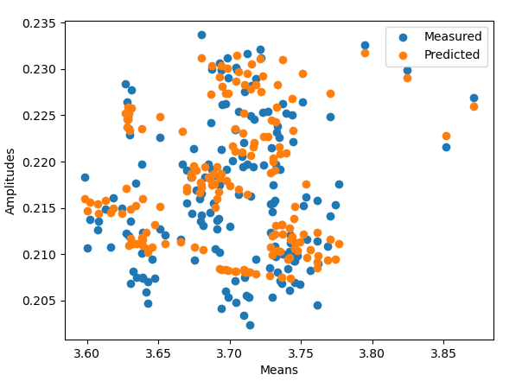
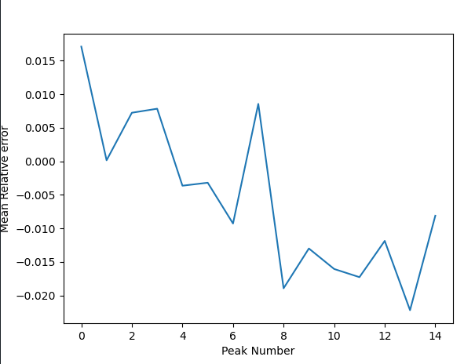
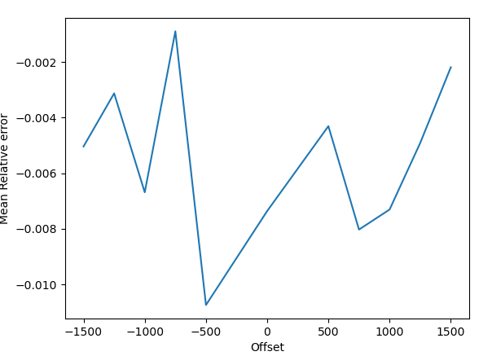
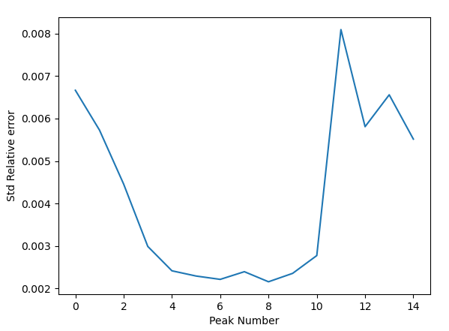
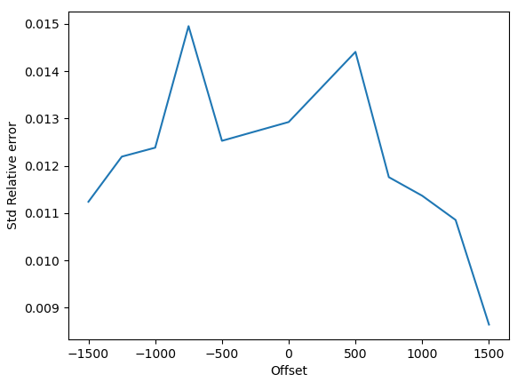
Do errors creep into our measurements?
I have been careful to measure in center of linear region.
The question is whether the calibration fit and offset measurements can predict the amplitudes that I measure.
Here’s a comparison of July 12 (xtraj, yoffset) data:
There is a clear trend in error when grouping by peak number.
What could be the cause?
Decaying signal? Should be able to see ray amplitudes decay with peak number then…
There is no discernable trend when grouping by offset
The standard deviations of relative error when grouped by offset are all around 1%
The predicted amplitude does use wirepositions at each peak fitted from the measurements.
Still, my reasoning says that if measurements worsened at larger offsets, we should see a trend here.

Slide 3
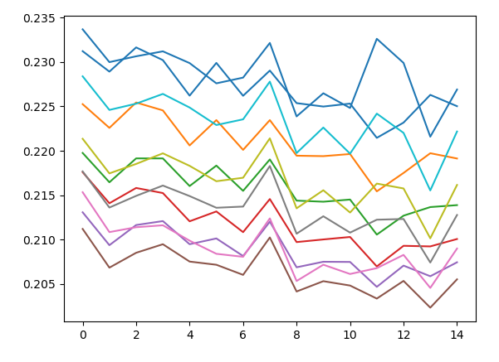
Decaying Signal
Sorry for no labels. This is amplitude vs peak number grouped by offset. There seems to be a clear decay in the signal.
Caused by dispersion?
Would this explain why the STD of the relative error is largest at the beginning and end of signal?
We should have considered dispersion before, we have seen visible ripples after the signal…
The final deflection measurements did have the xdeflection larger than the ydeflection (xlaser measures before the ylaser).

